Slide 1
Time Series
Saravana

Slide 2
Time Series
A time series is a sequence of numerical data points in successive order, Time series forecasting is the use of a model to predict future values based on previously observed values.
Time series models are very useful models when you have serially correlated data. Most of business houses work on time series data to analyze sales number for the next year, website traffic, competition position and much more.
As the name suggests, it involves working on time (years, days, hours, minutes) based data, to derive hidden insights to make informed decision making.

Slide 3
Examples
March April May June
100 110 120 ?

Slide 4
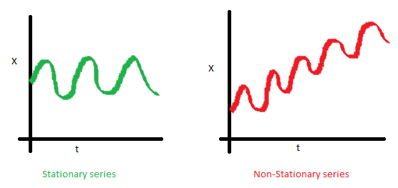
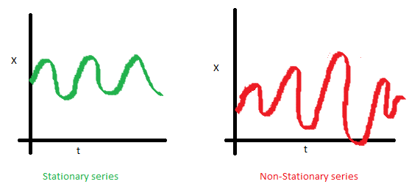
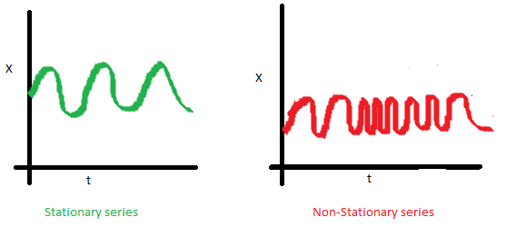
Stationary Series
There are three basic criterion for a series to be classified as stationary series :
1. The mean of the series should not be a function of time rather should be a constant.
2. The variance of the series should not a be a function of time.
3. The covariance of the i th term and the (i + m) th term should not be a function of time.

Slide 5
ARIMA
If you use only the previous values of the time series to predict its future values, it is called Univariate Time Series Forecasting.
And if you use predictors other than the series (a.k.a exogenous variables) to forecast it is called Multi Variate Time Series Forecasting.
ARIMA, short for ‘AutoRegressive Integrated Moving Average’, is a forecasting algorithm based on the idea that the information in the past values of the time series can alone be used to predict the future values.

Slide 6
What does the p, d and q in ARIMA model mean?
where,
p is the order of the AR term
q is the order of the MA term
d is the number of differencing required to make the time series stationary

Slide 7
Thanks

